Slide 1
WIP - Tibl
Adam Rivelli
Ali Grace
Jagath Jai Kumar
Jeremy Kelleher
Sagar Arora

Slide 2
Our App
A social networking application for students to build a community amongst their classes.
Students are subscribed to a twitter like news feed for all the classes they are enrolled in.
Students can view other students’ profiles, directly message students, and post on a newsfeed.
Students can also view overlapping classes so they can connect and build a relationship within the class.
Notes:
Sagar

Slide 3
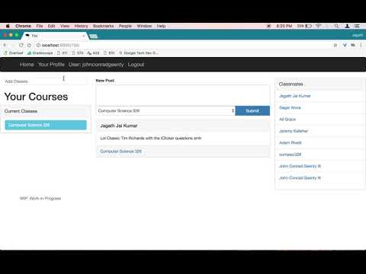
Notes:
Connecting with students in you current classes. Finding students you’ve taken previous courses with. Posting and reading posts about your courses. Students can view and add current/past classes.

Slide 4
Target Audience
Students!
Students looking for an easy way to:
Meet and contact their classmates
Ask people about classes they’ve taken
Form study groups with classmates
Get class recommendations from peers
Notes:
Jagath

Slide 5
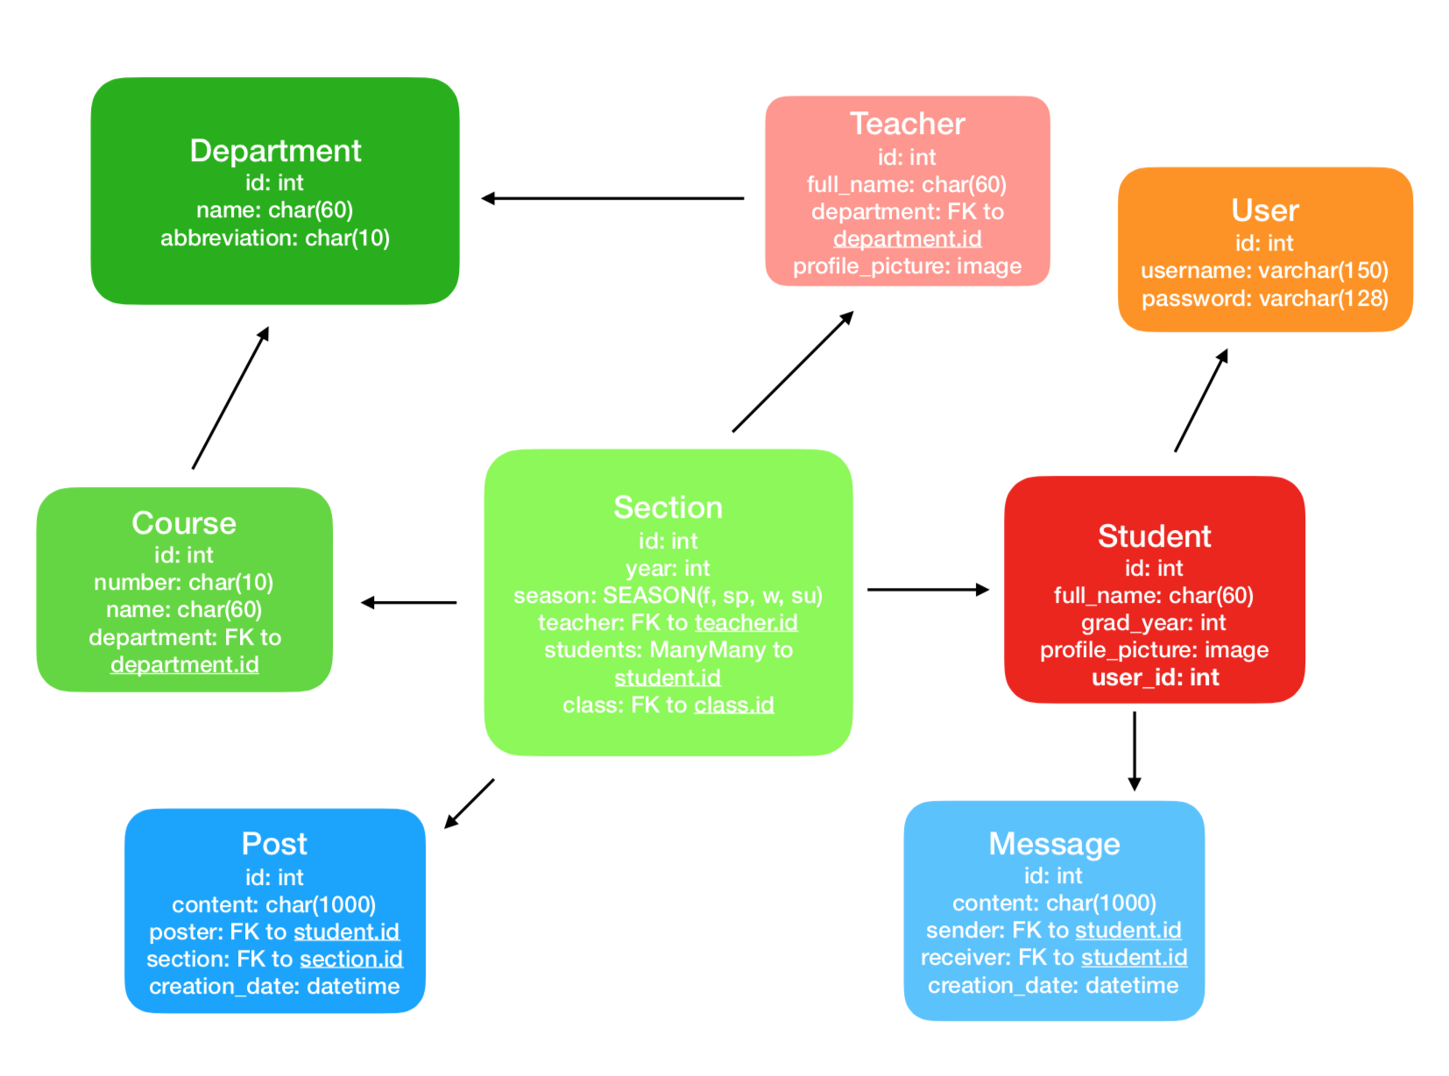
Notes:
J kelly

Slide 6
Easy Tasks
Hard Tasks
Styling pages and general layout
URL mapping
Adding Mock Data
Team decision making process - design
Making the data model
Form interaction
Working through git conflicts
Data requests for each view
Notes:
Adam

Slide 7
Future Work
Private messages between individuals and groups.
Recommended classes - classes your peers took.
Replies to posts.
Post images (memes).
Group-made study guides.
Notes:
Adam

Slide 8
WIP - Tibl
Adam Rivelli
Ali Grace
Jagath Jai Kumar
Jeremy Kelleher
Sagar Arora

